Slide 1
HearWay
Inclusive Urban Mobility
UID PROJECT 2025-2026
Moise Mihai
Pop Alexandra
Rádi Csabai

Slide 2
Intro
We are a team of students from the Technical University of Cluj-Napoca.
This presentation serves to demonstrate the practical application and understanding of User Interface Design principles studied in our coursework.

Slide 3
The problem & domain
Our initiative, HearWay, aims to enhance public transit accessibility for individuals with auditory or visual impairments.
Target audience
While HearWay features an inclusive, intuitive design suitable for all commuters, it is specifically engineered to address the unique navigational requirements of blind and deaf users.
We enhance these users with greater autonomy and efficiency throughout their journeys by providing streamlined access to specialized features through our mobile application.

Slide 4
The problem domain and technologies used
HearWay provides a unique opportunity to master modern mobile architecture using Kotlin and Jetpack Compose.
Haptic feedback
Text-to-Speech (TTS)
In the future
Braille keyboard integration
Real-time Voice-to-Text (RTVTT)
Context driven application
Emerging neural interface technologies
Beyond standard design, the project involves implementing specialized accessibility assistive interfaces—including:

Slide 5
Prototype Demo
Although the application can have several usability scenarios, in this demo we will cover only three scenarios
Scenario 3
Silent Emergency
Reporting
Scenario 1
Navigation
UI Design
Scenario 2
Communication

Slide 6
Navigation in Noisy or Crowded Environments
2.1
Navigation
Challenge: Deaf and blind commuters often miss their bus or metro stops in noisy, crowded environments where traditional announcements are unreliable.
Solution: HearWay provides automatic transit alerts using GPS tracking, haptic feedback, and high-contrast visuals to ensure users know exactly when to exit.

Slide 7

Innovation - Multi-Sensor, Exit Detection
The Problem: GPS alone can trigger false alerts if the bus stops in traffic.
The Solution: Combines GPS geofencing + accelerometer data to confirm the vehicle has actually stopped.
How it Works:
● Journey Progress: Visual progress bar fills up as you approach
● Prepare Alert: Haptic pulse + TTS warning before stop
● GET OFF NOW: Bright green screen + strong vibration when stopped

Slide 8
2.2
Communication
Communication for the Deaf people is difficult because people are biased that they are communicating with a healthy person.
Communication for the Blind people is difficult because they “see” the world very differently.

Slide 9

2.2
Communication
Live camera
Voice to speech
Text to speech

Slide 10
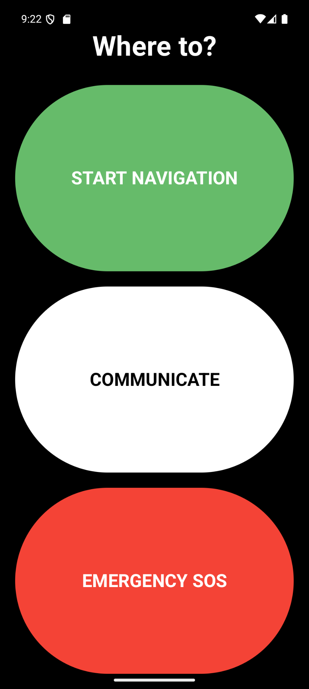
2.3. Silent Emergency Reporting
Context: We identified high-risk contexts, such as harassment on public transport or sudden medical emergencies. In these moments, a user with visual or hearing impairments is extremely vulnerable.
Challenge: The main challenge is that the user often cannot speak to call 112 or look at their screen to find a panic button without putting themselves in more danger. Traditional interfaces require visual attention, which is not safe here.
Solution: My solution is a Stealth Mode that enables Eyes-Free Interaction. By using Haptic Feedback and overriding the Physical Volume Buttons, the user can trigger and confirm an alert while keeping the phone hidden in their pocket or bag.

Slide 11
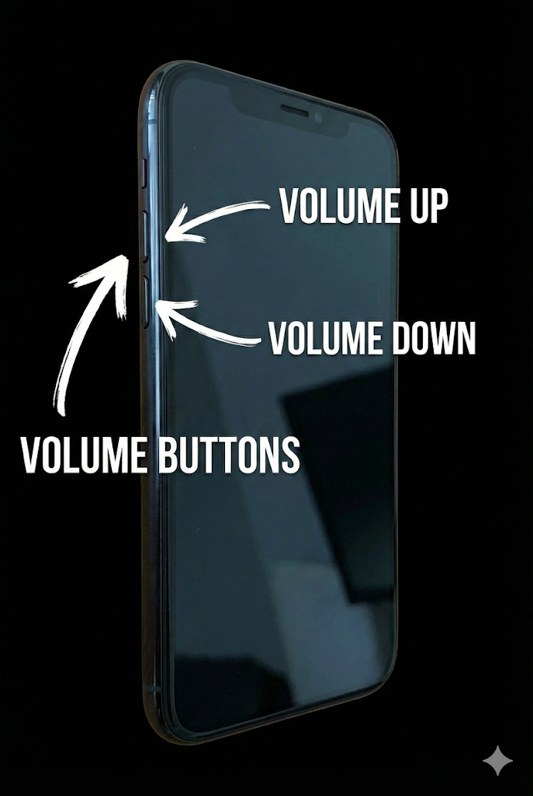
2.3. Innovation - Eyes-Free Navigation
The Problem: Touchscreens are difficult to use during panic or for visually impaired users.
The Solution: Hardware Key Override using KeyEvent.
How it Works:
Volume Down (⬇): Cycle Options (Medical -> Fire -> Security).
Volume Up (⬆): Confirm & Send Alert.

Slide 12
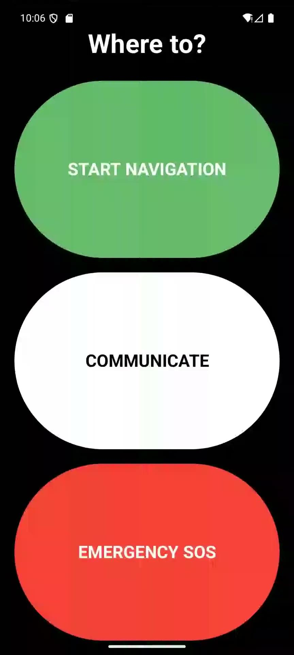
Action: User triggers "Medical" alert via physical buttons.
System Response:
Visual: Green "Emergency Reported" Screen.
Haptic: Reassuring "Double-Pulse" vibration.
Data Sent: Live GPS Location + User Medical Profile.
2.3. Scenario A: Successful Medical Report

Slide 13

2.3. Scenario B: Error Handling
Risk: Accidental activation in pocket.
Mechanism: -10 Second Timeout Logic.
Outcome:
If no confirmation -> Auto-Cancel.
Distinct "Cancellation" Vibration.
Prevents false alarms to authorities.

Slide 14
2.3. Technical Implementation
1. Hardware Input Interception
Logic: Overrides onKeyEvent to intercept system volume triggers.
Mechanism: Maps VOLUME_DOWN to a circular navigation list and VOLUME_UP to specific confirmation actions.
Benefit: Enables complete "Eyes-Free" interaction without looking at the screen.
2. Adaptive Accessibility
Context-Aware: Checks isBlind user profile state.
Feedback Loop: Dynamically switches between Silent Mode (Pure Haptics using VibrationEffect) and Audio Mode (TtsManager) based on user needs.
3. Data Payload Construction
Security: Generates a structured JSON object.
Content: Encapsulates Live GPS Coordinates, Timestamp, and Medical Profile ID to ensure dispatchers receive actionable data instantly.

Slide 15
Section 2.2
2.4
UI Design
Dynamic UI Profiles
The interface is Context-Aware: it detects user profile states (Blind/Deaf) to instantly swap between Vibration Effect (Silent Haptics) and TTSManager (Audio guidance)
High-Cognitive-Load Safeguards
Implementation of 5-second confirmation Windows and large-scale touch targets to mitigate accidental triggers during high-stress navigation or medical emergencies.

Slide 16
Section 2.2
2.4
UI Design
Haptic-First Architecture
Replaces visual confirmation with a Haptic Hierarchy: Unique vibration signatures for "Success" (Double-Pulse) vs. "System Error/Cancel"(Long-Pulse).
Physical Hardware interception
Utilizes Kotlin onKeyEvent to transform volume rockers into a binary navigation tool, enabling 100% Eyes-Free emergency reporting from a pocket or bag

Slide 17
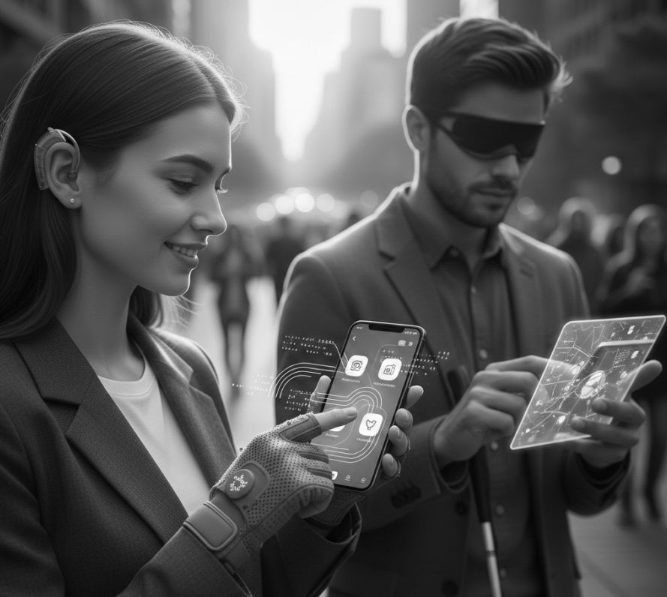
HearWay
Helping you navigate, communicate, and reporting trouble — all from your pocket.

Slide 18
“For blind and deaf users, accessibility is not convenience; it is independence.”
- Unknown Author

Slide 19
Mobile technology uniquely enables accessibility for blind and deaf users through built-in sensors, constant availability, and assistive features that support independent, real-world interaction.
It requires specialized accessibility engineering to provide life-changing digital independence and inclusive equity.

Slide 20

Thanks!

